Slide 1
Suicide Prevention AMP
February 17, 2026
Mark Reger, PhD, ABPP

Slide 2
Agenda
The Challenge
Portfolio Overview
Priorities
Accomplishments
Strategic Initiatives

Slide 3

The Challenge
Suicide is a ‘Wicked Problem’: One of the most vexing, challenging problems in the Veteran health care mission
Multi-level: Psychological, social, biological
Many paths have been tried
Requires a sustained commitment to innovative, cutting-edge science

Slide 4


Needle in a Haystack
100,000 tiny dots, representing 100,000 Veterans
Veteran suicide rate = 35.2 per 100,000 (Red dots).
If we were able to identify suicide risk as well as depression screening (about .80 sensitivity, .70 specificity), then 28 of the 35 suicides could be identified (Green shading).
However, ~30,000 additional Veterans who were not at risk would also be identified as at risk (Blue dots).

Slide 5
Why Suicide Prevention Research?
“I got one of those (research) cards at the most opportune moment. I was having a bad time, and I’d get a card in the mail that said, “We’re just thinking about you and were just seeing how you are doing,” and I was like damn people do care about me. I do have something.”
Veteran Research Participant #1
“(The research intervention) helped me understand that I wasn’t alone in my daily struggles or my daily battles, and that I would always have somebody to call or if I needed to reach out, I had somebody to talk to. “
Veteran Research Participant #2

Slide 6
ORD Investigators, Scientific Review and Management (ISRM)
ISRM Leadership Team
TBI
Suicide Prevention
Pain/Opioid Use Disorders
Precision Oncology
Health Systems Research
Rehabilitation Research Dev. & Translation
Medical Health Research
Brain, Behavioral and Mental Health Research
Gulf War/ Military Exposures
Actively Managed Portfolios
Broad Portfolios
Focused purviews and impacts
Broad purviews, Capacity-building
ISRM Operations: Business Management, Information Analytics, Clinical Trials, Scientific Review Support
ISRM funds VA-employed investigators to conduct research projects across the translation spectrum that address VA and Veteran priorities and needs. VA investigators can apply to different portfolios using the same RFA mechanisms.
pre-decisional

Slide 7

Suicide Prevention Actively Managed Portfolio (SP AMP)
Mission: To help Veterans create lives worth living by advancing science that leads to actionable improvements in Veteran suicide prevention.

Slide 8
Portfolio
Suicide Prevention (SP) AMP launched Oct 1, 2024
48 Active Projects
34 merits; 13 pilots; 1 SDR
0 animal studies; 48 human subjects
3 Basic/Foundational
15 clinical trials
5 epidemiology
2 Genomic
PREDECISIONAL – INTERNAL USE ONLY

Slide 9
Priorities

Slide 10
Determining Priorities & Establishing a Strategic Roadmap
Name | Role | ESC Function
Department of Veterans Affairs – Office of Research & Development |  | Constituency
Wendy Tenhula | Deputy Chief Research and Development Officer | Voting Member
Kara Beck | QUERI Representative, ORD, Dept. of Veterans Affairs | Voting Member
Mark Reger | SP AMP Lead, ORD, Dept. of Veterans Affairs | Non-Voting, Ex Officio
Samantha Hack | SPM, HSR4, ORD, Dept. of Veterans Affairs | Non-Voting, Ex Officio
Matt Boehm | Acting SPM, MHBC, ORD, Dept. of Veterans Affairs | Non-Voting, Ex Officio
Peter Hunt | SPM, RDT4, ORD, Dept. of Veterans Affairs | Non-Voting, Ex Officio
Department of Veterans Affairs – ORD funded Suicide Prevention Research Centers |  | Constituency
Steven Dobscha | Co-Director, Suicide Prevention Research Impact NeTwork (SPRINT) | Non-Voting Member
Brian Marx | Co-Director, Suicide Prevention Research Impact NeTwork (SPRINT) | Non-Voting Member
Department of Veterans Affairs – Office of Suicide Prevention |  | Constituency
Todd Burnett | Acting Executive Director, Office of Suicide Prevention | Voting Member
Susan Strickland | Associate Director for Research and Evaluation, Office of Suicide Prevention | Voting Member
Edgar Villareal | National Clinical Director, Office of Suicide Prevention | Voting Member
VHA Stakeholders |  | Constituency
Jodi Trafton | Director, VA Program Evaluation and Resource Center (PERC) | Member
Bradley Watts | Research Director, VHA Office of Rural Health | Member
Nasi Bahraini | Director, Rocky Mountain MIRECC | Non-Voting Member
Stephanie Gamble | Director, CoE for Suicide Prevention | Non-Voting Member
Veteran Representative (Federal Employee) from Veteran Engagement Council
 | Veteran Representative | Voting Member
Executive Steering Committee is comprised of voting and non-voting member representatives from:
Federal agencies
Research centers
Veteran stakeholders
Affiliated programs
Eric Enone
Business Manager
SP AMP
External Federal Funding Agency Constituency
Jane Pearson | NIH Representative | Voting Member
Melissa Mehalick | DoD Representative | Voting Member

Slide 11
SP-AMP Research Priorities
AMP Priorities
Phase I: Identify research gaps and unanswered questions
Phase II: Refine priorities: national surveys/live voting & focus groups
Phase III: Delphi consensus panel
Lethal Means Safety
Precision Health Suicide Prevention
Suicide prevention in community settings
References: Aligning quality improvement efforts and policy goals in a national integrated health system - Braganza - 2022 - Health Services Research - Wiley Online Library; Health System Research Priorities for Children and Youth With Special Health Care Needs - PubMed (nih.gov); Research Lifecycle to Increase the Substantial Real-world Im... : Medical Care (lww.com)
Notes:
Phase 1: Identify research gaps and unanswered questions (e.g., SPM review, evidence inventories or reviews, VA program office strategic plans)
Phase II: Refine Priorities using concurrent processes: national surveys/live voting & focus groups with Consumer, Provider, Leader, Investigator groups
Phase III: Delphi consensus panel with interested party representatives rank priorities on urgency, impact, feasibility, identify impact metrics
General principles:
Priorities should reflect the research translation spectrum (e.g., T1-T4)
In-depth feedback from focus groups to identify topics not previously listed
Broad representation across interested parties via surveys, voting on top priorities
Perspectives from the front line

Slide 12

Lethal Means Safety (LMS)
The voluntary practice of creating distance between the methods of self-harm and the person in distress during a suicide crisis.
A Notice of Special Interest (NOSI) generated new LMS applications
Four new peer reviewed studies are under way, with more in the pipeline.

Slide 13

Precision Health Approach to Suicide Prevention
Problem: “One-size-fits-all” approaches can limit impact and result in misdirection of resources
Problem: Treatments are applied uniformly, including to those who may not need them
Some Veterans don’t get much benefit, and could do better with other treatments instead
Some Veterans may end up with worsening condition due to needs not being met

Slide 14
Establishing a Precision Health Research Center
Center for developing precision health approaches for suicide prevention
Develop suicide risk phenotypes that interact with treatment
Use VA data to conduct emulated clinical trials investigating person by intervention interactions
Use randomized clinical trial methods to validate precision treatment rules derived from center studies
Make recommendations for decision rules to direct clinical tools to select interventions based on phenotype
Individualized treatment approaches for suicide prevention
ORD Precision Health Research Center will utilize VA data to establish precision treatment rules to prevent suicide

Slide 15
On the Horizon: Suicide Prevention in the Community
FY 2027
The SP-AMP will be engaging stakeholders to define strategic opportunities:
Map the landscape of community-based suicide prevention
Engage community partners
Assess the current evidence base
Clarify priorities for research and innovation
Develop a strategic framework

Slide 16
Accomplishments

Slide 17
Select Project Accomplishments (1)
Veteran Feedback for Suicide Prevention Operations
Developed recommendations for the Office of Suicide Prevention based on Veteran feedback after VCL emergency dispatches.
https://pubmed.ncbi.nlm.nih.gov/39980364/
Machine Learning Prediction for Transitioning Service Members
Collaboration with DoD: 30% of service members with highest predicted risk account for 93% of medically serious suicide attempts within the first year following military discharge. Predictive analytics are now being tested in a stepped care intervention. https://pubmed.ncbi.nlm.nih.gov/39885116/
PREDECISIONAL – INTERNAL USE ONLY

Slide 18
Select Project Accomplishments (2)
Predicting Near-Term Risk among Veterans who Won’t Tell Us
Preliminary study of a novel test to reveal hidden attitudes about suicide risk faster than Veterans can consciously control them. Innovative approach needs more research.
https://pubmed.ncbi.nlm.nih.gov/41033177/
Million Veteran Program
ID’ed a “mild suicide ideation profile” that did not present with high-risk comorbidities but had the highest rate of suicide. Upstream suicide prevention interventions may be indicated.
https://pubmed.ncbi.nlm.nih.gov/41331360/
PREDECISIONAL – INTERNAL USE ONLY

Slide 19
Select Project Accomplishments (3)
Natural Language Processing (NLP) for VA Medical Records
Preliminary NLP in VA medical records to extract suicide risk information and predict risk – next steps identified.
https://pubmed.ncbi.nlm.nih.gov/39854062/
Peer Veteran Telehealth Options for Rural Veterans
Pilot study examined a telehealth suicide prevention group intervention (augmented with a peer Veteran) for rural Arkansas
https://pubmed.ncbi.nlm.nih.gov/40171305/
PREDECISIONAL – INTERNAL USE ONLY

Slide 20
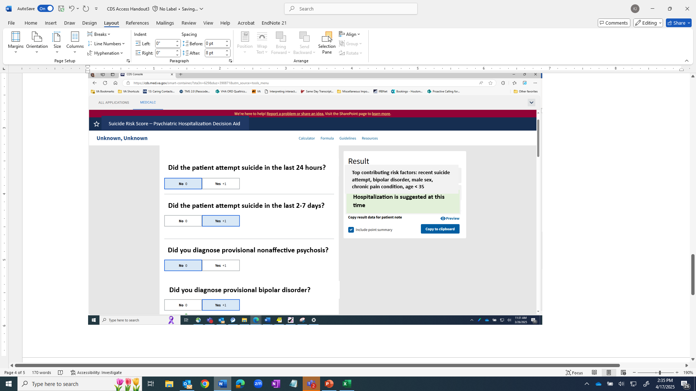
Precision Health Research to Practice: A Clinical Example
Development of a Predictive Analytics-Informed Clinical Decision Support Tool for
VA ED Providers
How do we support VA ED providers with Veterans presenting to the ED for suicide risk?
Predictive models on which Veterans benefit from which interventions
Developing improved risk assessment processes to help ED providers with decision making to reduce suicide risk

Slide 21
Strategic Initiatives

Slide 22

Suicide Prevention Research Impact NeTwork
One of 6 HSR/ORD-funded Consortia of REsearch (COREs)
Goal of CORES: Accelerate research that will lead to measurable improvements in the care delivered to Veterans across several priority areas.
SPRINT’s specific mission: To serve as a national resource that accelerates VA suicide prevention research to improve care and prevent Veteran suicide.
SPRINT funded since 2019; received 5-year renewal in 2024.
Primary Operations Partner: VA Office of Suicide Prevention

Slide 23

Common Data Elements
Centralized infrastructure for collecting, organizing, storing, and sharing standardized suicide research data
Addresses persistent challenges in suicide prevention (e.g., small sample sizes, inconsistent measurement approaches, low base-rate outcomes)
Specifically, the repository will enable:
Pooled analyses across multiple studies
Examination of what treatments work best for whom
Longitudinal follow-up beyond individual study timelines
Accelerated translation of research findings into clinical practice
CDE Requirement added to new applications as of March 12, 2026

Slide 24
Building Capacity through Data Curation and Data Education
Dataset Name | Description
Environmental and Social Determinants of Health (ESDH) | VA ESDH Data Collection includes 34 datasets spanning 5 key domains identified by the CDC’s Healthy People 2030 framework: Economic Stability, Education Access and Quality, Health Care Access and Quality, Neighborhood and Built Environment, and Social and Community Context. Pre-curated by ORNL. Located on PERC SQL Server.
Predictive modeling candidate predictor cohorts** | Data from multiple REACH VET and STORM cohorts. Each cohort has over 900 variables extracted from the EHR on over million Veterans. Used for predictive modeling to identify Veterans at high risk for suicide and/or overdose. Located on PERC SQL Server.
OSP Metrics & Clinical Concept Data** | Data used by OSP to evaluate performance. Includes diagnosis and service utilization data. Located on PERC SQL Server.
Predictor Pool | Instance level data computed for defined concepts in over 10 domains between 2016 and 2023 Integrated Oracle Health and VistA data. Located on PERC SQL Server.
Nightly updated predictive modeling | Data pulled nightly on Veterans to feed ongoing predictive modeling initiatives including STORM & REACH VET. Integrated Oracle Health & VistA data. Located on PERC SQL Server.
Natural Language Processing Clinical progress notes | Natural Language Processing (NLP) of data in the EHR. Located on PERC SQL Server. Large set of clinical progress note and other unstructured data available for further analysis. Located on PERC SQL Server.
NLP dataset | Natural Language Processing (NLP) of data in the EHR. Located on PERC SQL Server.
VCL | OSP working with VCL and Suicide Prevention Trials Database to create access in FY2025. Will be cleaned, harmonized with other SPTD individual data.
OSP/Office of Mental Health (OMH) Gold Standard Data | Suicide and Overdose Events; VA Comprehensive Suicide Risk Evaluation (CSRE) data; VA Suicide Behavior and Overdose Report (SBOR); VA Mental Health Assistant; VA Patient Record Flags; VA Safety Plan; Suicide Risk Management. Integrated Oracle Health and VistA data. Located on PERC SQL Server.
Pharmacy: Medication Possession Ratio products | Medication possession ratio computation for all outpatient dispensed drugs. Multiple datasets with curated information on dispensed information, for example daily dose, active drugs and more. Integrated Oracle Health and VistA data. Located on PERC SQL Server.
Advanced Library Exchange (ALEX) | Library with clinical concept definitions based on value sets defined in standard vocabularies. Integrated Oracle Health and VistA data. Located on PERC SQL Server.
Ira Master File (IMF) | Repository for MH patient level data collected yearly 2010-current, used in operations. Integrated Oracle Health and VistA data. Located on PERC SQL server.
SPRINT Project level datasets | National Vietnam Veterans Readjustment Study and National Vietnam Veterans Longitudinal Study Registry datasets, Veterans’ After-Discharge Longitudinal Registry data, Includes data from over 600,000 Veteran patients across VHA. Located on VA Boston server.
Military Suicide Research Consortium (MSRC) Data | Military Suicide Research Consortium’s Common Data Elements (v. 1.0, 2.0) which includes data from DoD-funded studies on active-duty service members and Veterans. Available through SPRINT website, located on VA Boston server.
County Suicide data | Available through 2020.
Office of Health Equity | Additional ESDH Data complementary to PERC/ORNL ESDH Dataset
Suicide Prevention Trials Database (SPTD) | Publicly available FAIR data resource²⁴. Continuously updated study-level data from all published SP trials dating to 1980. SPTD Leads received OSP funding in FY2024/2025 to incorporate individual study participant data into the database as well.
Suicide Death Data | SPDR Team will facilitate requests for data from Joint Department of Defense – Department of Veterans Affairs Suicide Data Repository (SDR); contains Military Veteran Mortality database
Suicide Prevention Learning Community is an ongoing, QUERI-funded effort to develop capacity for utilizing VA data in development of precision medicine approaches to suicide prevention.
Aims
Advance access to OSP and PERC datasets.
Develop SharePoint site that includes
Information on available data
SOPs for accessing and working with data
SOPs for consultation and support
Integrated data to be used for understanding characteristics of the Veteran that moderate and mediate suicide prevention interventions.

Slide 25

Q&A

Slide 26
Back-Up

Slide 27
2025 SP AMP Applications

Slide 28
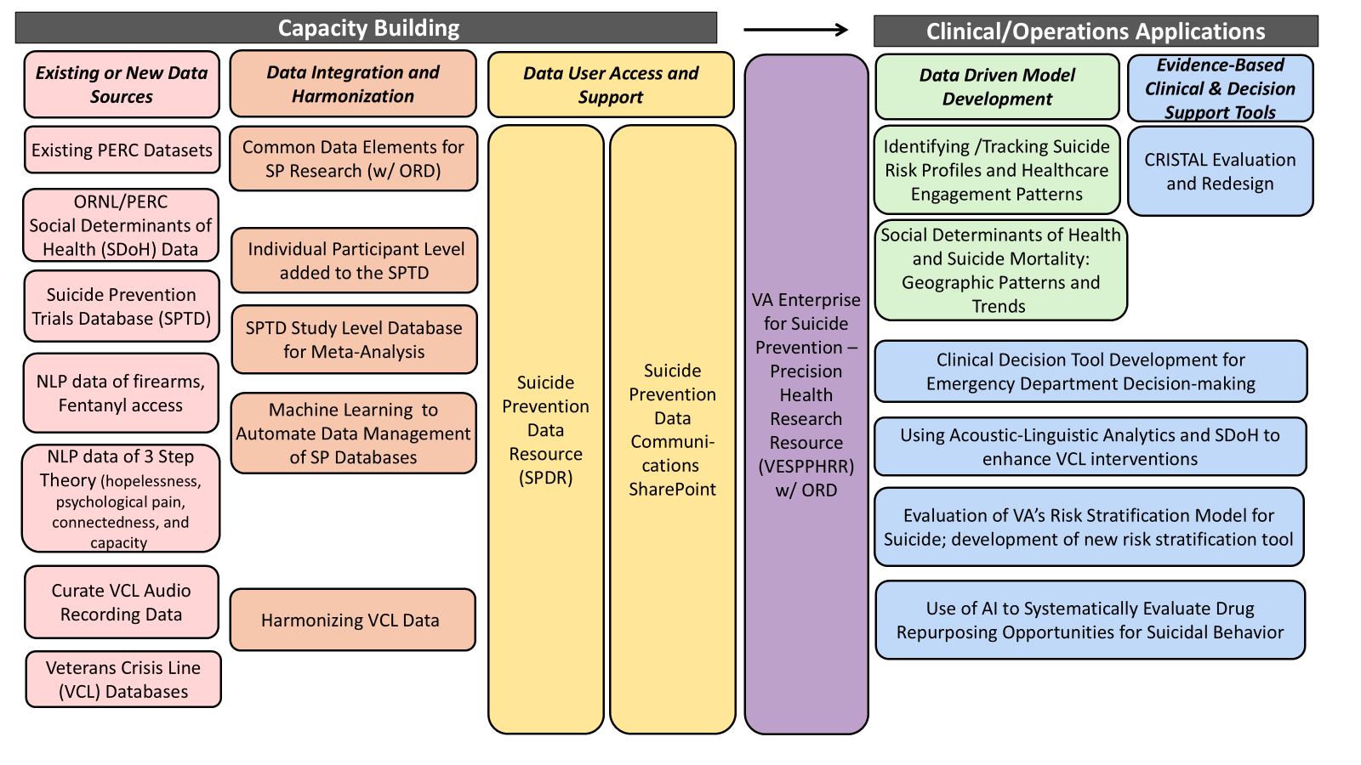
Strategic Roadmap to Precision Medicine Approaches
Current Effort
Commence FY26
Clinical Outcome

Slide 29
Suicide Prevention –Transitioning Service Members
VA Investigators evaluated Veteran Sponsorship Initiative (VSI+): a precision medicine tool for suicide prevention for service members as they transition into civilian life
Problem: VA investigators previously demonstrated that the suicide rate for Veterans aged 18 to 34 years old more than doubled since 2001
2.5x risk in 1st year after the military (Sokol et al 2021; Geraci et al 2020; Shen et al 2016; Ravindran et al 2020)
VSI+: uses predictive analytics to identify service members at high risk for suicide
VA investigators found:
30% of service members with highest predicted risk by VSI+ account for 93% of medically serious suicide attempts within the first year following military discharge (Kearns et al, 2023)
VSI+ enables connecting high-risk service members—before they leave the service—to stepped-care interventions e.g., peer sponsors, community services, VA benefits and health care (Hannon Act Section 101) including specialty care for military environmental exposures, mental health, TBI, and physical therapy
Next Steps:
Partnering with VHA/VBA, DOD, and community partners to improve and integrate predictive analytics into enterprise-wide efforts to reduce Veteran suicide, homelessness, & unemployment, e.g., partnership with Post-9/11 Military 2VA Case Management Program to prioritize their outreach efforts based on risk scores
Integrating/expanding tool to predicting and preventing Veteran homeless and unemployment
“I got into a really dark place. If it wasn't for your help especially with VA medical care I don't think I would've climbed out successfully. Just know you totally made a difference in this combat Veteran's life as well as his family’s.” -Veteran participating in Veteran Sponsorship Initiative
Notes:
Joe Geraci, PhD working with VBA Outreach, Transition and Economic Development; VHA National Center for Healthcare Advancement and Partnerships; VHA Post-9/11 Military to VA Case Management; VHA Innovation Ecosystem; VA Office Information & Technology; VHA Office of Mental Health & Suicide Prevention; VHA Undersecretary for Health; VHA Office of Primary Care; DoD Uniformed Services University; Harvard Medical School; ETS Sponsorship (non-profit)

Slide 30
Suicide Prevention – Virtual Access to Care
Impacts of virtual mental health care
VA Investigators found:
all VA facilities offer virtual mental health care, contributing to higher patient satisfaction. Of consistent users of VA mental health services, 54% of Veterans exclusively receive mental health care via telehealth (Lum et al. 2024)
A 1% increase in video-based mental health visits correlates with a 2.5% decrease in suicide-related events (Tenso et al. 2024)
Impacts of issuing electronic tablets to Veterans for virtual mental health care
VA Investigators found:
222,977 Veterans have received a VA-issued tablet since the program was launched in 2015 (35% are rural Veterans
Program improves access, continuity, and efficiency of care (Jacobs et al. 2019)
Veterans who received tablets experienced increased mental health service use and 36% reduction in the likelihood of having a suicide-related emergency department visit (Zulman 2022)
“[The tablet] makes communication with the VA counselors and psychiatrists and heart doctors... so much easier and more convenient.” -Veteran tablet recipient

Slide 31
Suicide Prevention - Lethal Means Safety
Problem: Firearms are used in over 70% of Veteran suicides
Lethal means safety (LMS): suicide prevention strategies that increases time and distance between a firearm and an individual at risk
VA Investigators Evaluated:
The Armory Project: a community-engaged approach to LMS, has partnered with 16 firearm retailers across Louisiana, reaching 2,000 Veterans.
Contributed to the passage of legislation: Louisiana ACT 453: Provides immunity from civil liability for firearm retailers who store firearms for a person in need; Louisiana ACT 295: Creating an online handgun education course curriculum on preventing Veteran firearm suicide
Project Life Force (PLF): a telehealth suicide safety planning/firearm safety group intervention for high-risk Veterans, including those in rural settings or who do not seek VA care
“Obviously, a gun store is not traditionally thought of as a place where you go to talk about mental health. But you have this brochure in front of you, and that opens things up... we've had multiple conversations that are beneficial for all.” - Gun Shop Owner
“The PLF program had a huge impact on me. ... I no longer store my loaded firearms by my bedside and my wife is now on my safety plan. She is glad to be part of my treatment.” - Lived Experience Peer
Notes:
The Armory Project: Gala True working with Office of Suicide Prevention.

